Slide 1
Building Project Management Value through Strategic Alignment
Professional Development Conference
PMI-SAC, Calgary, Alberta
Fadi Samara, M.Sc., PMP
fadisamara@hotmail.com
416-848-7115
Oct 13, 2005

Slide 2
Getting Value from Project Management
Benchmarking PM value
How do the three P’s fit together
Leadership in Project Management through Strategic Alliance

Slide 3
Measuring Project Success
Typical Project Success Metrics
Project/process execution
Financial performance
Customer satisfaction
Employee satisfaction
Think like a Business
  Throughput
  Investment
  Operating Expense
The Value of products and services you deliver
To customers minus cost of goods or services
sold or paid to outside vendors.

Slide 4
Why is it so hard to assess PM value
We never put a plan to build the PMO
Most Project management disciplines are typically initiated by large initiatives such as major new product or service category or major organizational change
Senior Management does not see the link to their strategies
Project Managers are about “Get the job done”; no time to bench mark

Slide 5
Three P’s – PMI Definition
Portfolio
A collection of projects or programs and other work that are grouped together to facilitate effective management of that work to meet strategic business objectives. The projects or programs of the portfolio may not necessarily be interdependent or directly related
Program
A program is group of related projects managed in a coordinated way to obtain benefits and control not available from managing them individually. Programs include an element of ongoing work and may include elements or related work outside the scope of discrete projects in the program
Project
A temporary endeavor undertaken to create a unique product, service, or result

Slide 6
Putting the P’s together – A High Level Project Portfolio Management Model
Strategic
Planning
Strategic Initiatives
Business Unit
Planning
Capital
Management
New Objectives
Programs
A
N
N
U
A
L
NPI
Technology
Operations
Project
Portfolio
Management
A
ssess Value
B
Quarterly
alance Capacity
C
ommence Execution
Project
Management
Remove Low Value
Projects
Reassess Executing
Projects
Monthly
Post Audit
Complete

Slide 7
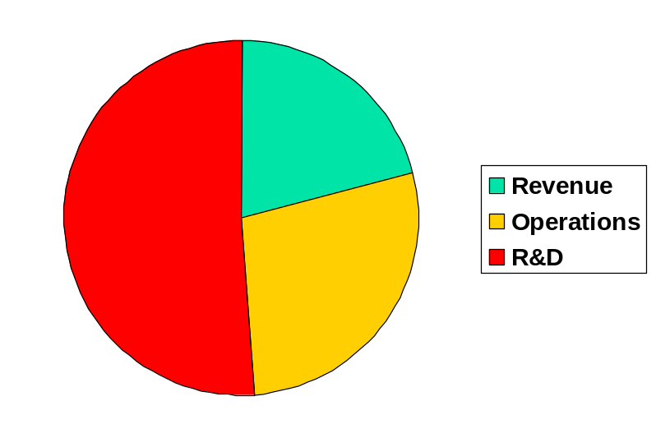
Portfolio Management linked to Strategic Planning
Portfolio Management is the middleware between Strategic Planning and Project Delivery.
Portfolios provide a cohesive view to track and align the priorities as set by the Strategic Planning process.

Slide 8
Program Management linked to Strategic Planning
Program Management provides the alignment of Strategic Objectives to delivery streams (programs) that achieve business value as set by the Corporate Strategic plan.
Programs provide the intersection framework between Strategic Objectives and Technology infrastructure and provide a clear alignment to Executive Sponsors.
Through these programs, Funnel management is aligned to the weight associated with each program and thus with each Strategic objective in terms of priority and value to the strategy.

Slide 9
Project Portfolio Management Detailed Model
Strategic
Planning
Strategic Initiatives
Business Unit
Planning
New Projects
Pre-Assessment
Screened
A
N
N
U
A
L
Project
Portfolio
Management
Unapproved
Portfolio Screening
In-Progress Projects
On-Hold Projects
Project Scoring
Quarterly
Unapproved
Portfolio Ranking
Portfolio
Simulation
Approved and
not Resourced
Out of Capacity
Approved
Project
Management
Portfolio
Monitor
In-Progress Projects
On-Hold Projects
Monthly
Cancelled
Post Audit
Complete

Slide 10
A-B-C Process of Project Portfolio Management
 | Portfolio Management
 | Assess | Balance | Commence
Program Management | Do Projects meet Watershed Criteria? Score Projects Rank Projects Review Project Resource needs & Variances Identify dependencies and overlaps | Mitigate Portfolio Risk Optimize Portfolio Value Simulate Alternative Scenarios Equalize Capacity and Demand Reallocate key Resources Remove Overlaps Change, add, Delete project schedules | Issue Portfolio Makeup Emphasize link to Strategy Reassign resources Re-plan existing projects Start New projects Terminate misaligned projects
 | Project Management

Slide 11
Project Portfolio Management Processes
Process | Functionality
Project Screening | Filter projects based on high-level watershed criteria. New projects are entered once management reach consensus on which projects are aligned with business objectives
Project Scoring | Projects are qualified (rejected or approved) based on internal goals and predefined threshold metrics such as cost, risk, IRR, risk level, and ROI. Newly screened, on-hold, out of capacity, or in progress projects are filtered through this process. Based on predefined scoring criteria, projects are sorted.
Project Ranking | Display project ranking based on criteria such as total score, cost, revenue, risk level, ROI, and others. Override projects from “Approved and not resourced” to “Unapproved”, based on corporate strategy and business objectives

Slide 12
Project Portfolio Management Processes… continued
Process | Functionality
Portfolio Simulation | Simulate “Approved and not resourced” and “Must do projects” and select ones that fit budget and resource constraints. Put unselected or “Out of capacity” projects back to the screening module. Ensure that “Must do projects” are approved. Manage skills inventory for optimum utilizations. Allocate resources on projects, move resources from one project to another, put resources back on the resource pool.
Portfolio Monitoring | Alert appropriate individuals when critical schedule, financial, or resource thresholds are exceeded or project conflicts arise. Monitor overall performance of “Approved” or “In-progress” projects. Change the state of projects – put project on hold, cancel project, or change project from “In-progress” to “Complete”
Portfolio Definition | Define portfolio group threshold and corporate threshold criteria. Based on company’s specific business goals, define scoring rules and metrics. Define resource pool and skill inventories Define project alert criteria

Slide 13
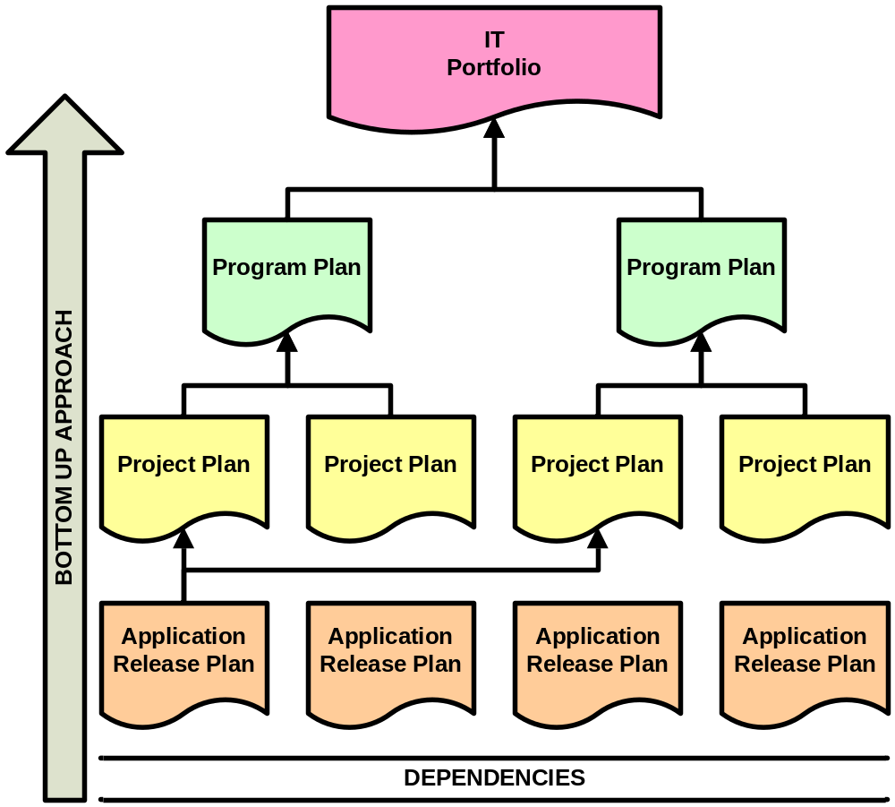
Build a portfolio plan with 3 P’s in mind
Portfolio deliverables
& dependencies
Program deliverables
& dependencies
Project deliverables
& dependences
Construction Stage
deliverables
& dependencies

Slide 14
Executive Portfolio Summary
Strategic Initiative | Program | Objective | Idea & Sponsor | Project | % of Objective | Original & Current End Date | Original & Current Budget | Status
Billing | Billing | Reduce Invoice Production cost by 20% | Promote eBilling | Create Marketing Campaigns - VP Billing | 60% | 23/SEP/03 | $300K | Green
 |  |  |  | Introduce ePost - VP Billing | 40% | 28/NOV/03 10/FEB/04 | $200K $275K | Yellow

Slide 15
Implementing PM while demonstrating value
Phase I (6months to a year)
  Identify Pains Points of Executives & Key Initiatives
  Structure programs around these pain points and Key initiatives
  Demonstrate value by measuring benefits that relate to the business
  Promote Project management by “doing it”
Phase II (1 year)
  Start you own PMI chapter; promote PMP designation
  Initiate Project Management Methodology Development
  Build a Program Structure that aligns with Strategic Planning process
  Develop a Portfolio that ties to strategy, programs, and key Executives
  Hire & develop Program Managers to support key strategic initiatives

Slide 16
Implementing PM while demonstrating value
Phase III (1 year)
  Build Best Practices for Project Management; become a Centre of Excellence
  Further develop Program Management staff to become General Managers
  Facilitate the Strategic Planning process
  Implement Strong Capital Management process
  Enhance the organizational positioning of the PMO
  Decentralize the PMO

Slide 17
Leading the Profession
Run Project Management like a business
  Measure success like we measure business success
  Do not focus on Cost only; Focus on Throughput
Establish an organization to run Programs
  Develop General managers that run Programs like a business
  Align resources to Programs
Integrate to the Executive management processes
  Build a strong link to Strategic Planning; work closely with CXO’s
  Manage the capital process; work closely with Finance

Slide 18
How do you know you succeeded?
When a Business Sponsor picks the phone and calls PMO executive asking for a PM to deliver a major cross functional initiative
When you have contributed to Executives meeting their own objectives
When the Portfolio Management Process is intertwined with the Strategic and Business Planning processes

Slide 19
Your Thoughts
Questions & Answers

Slide 20



Change is Constant
Resilience

